Slide 1
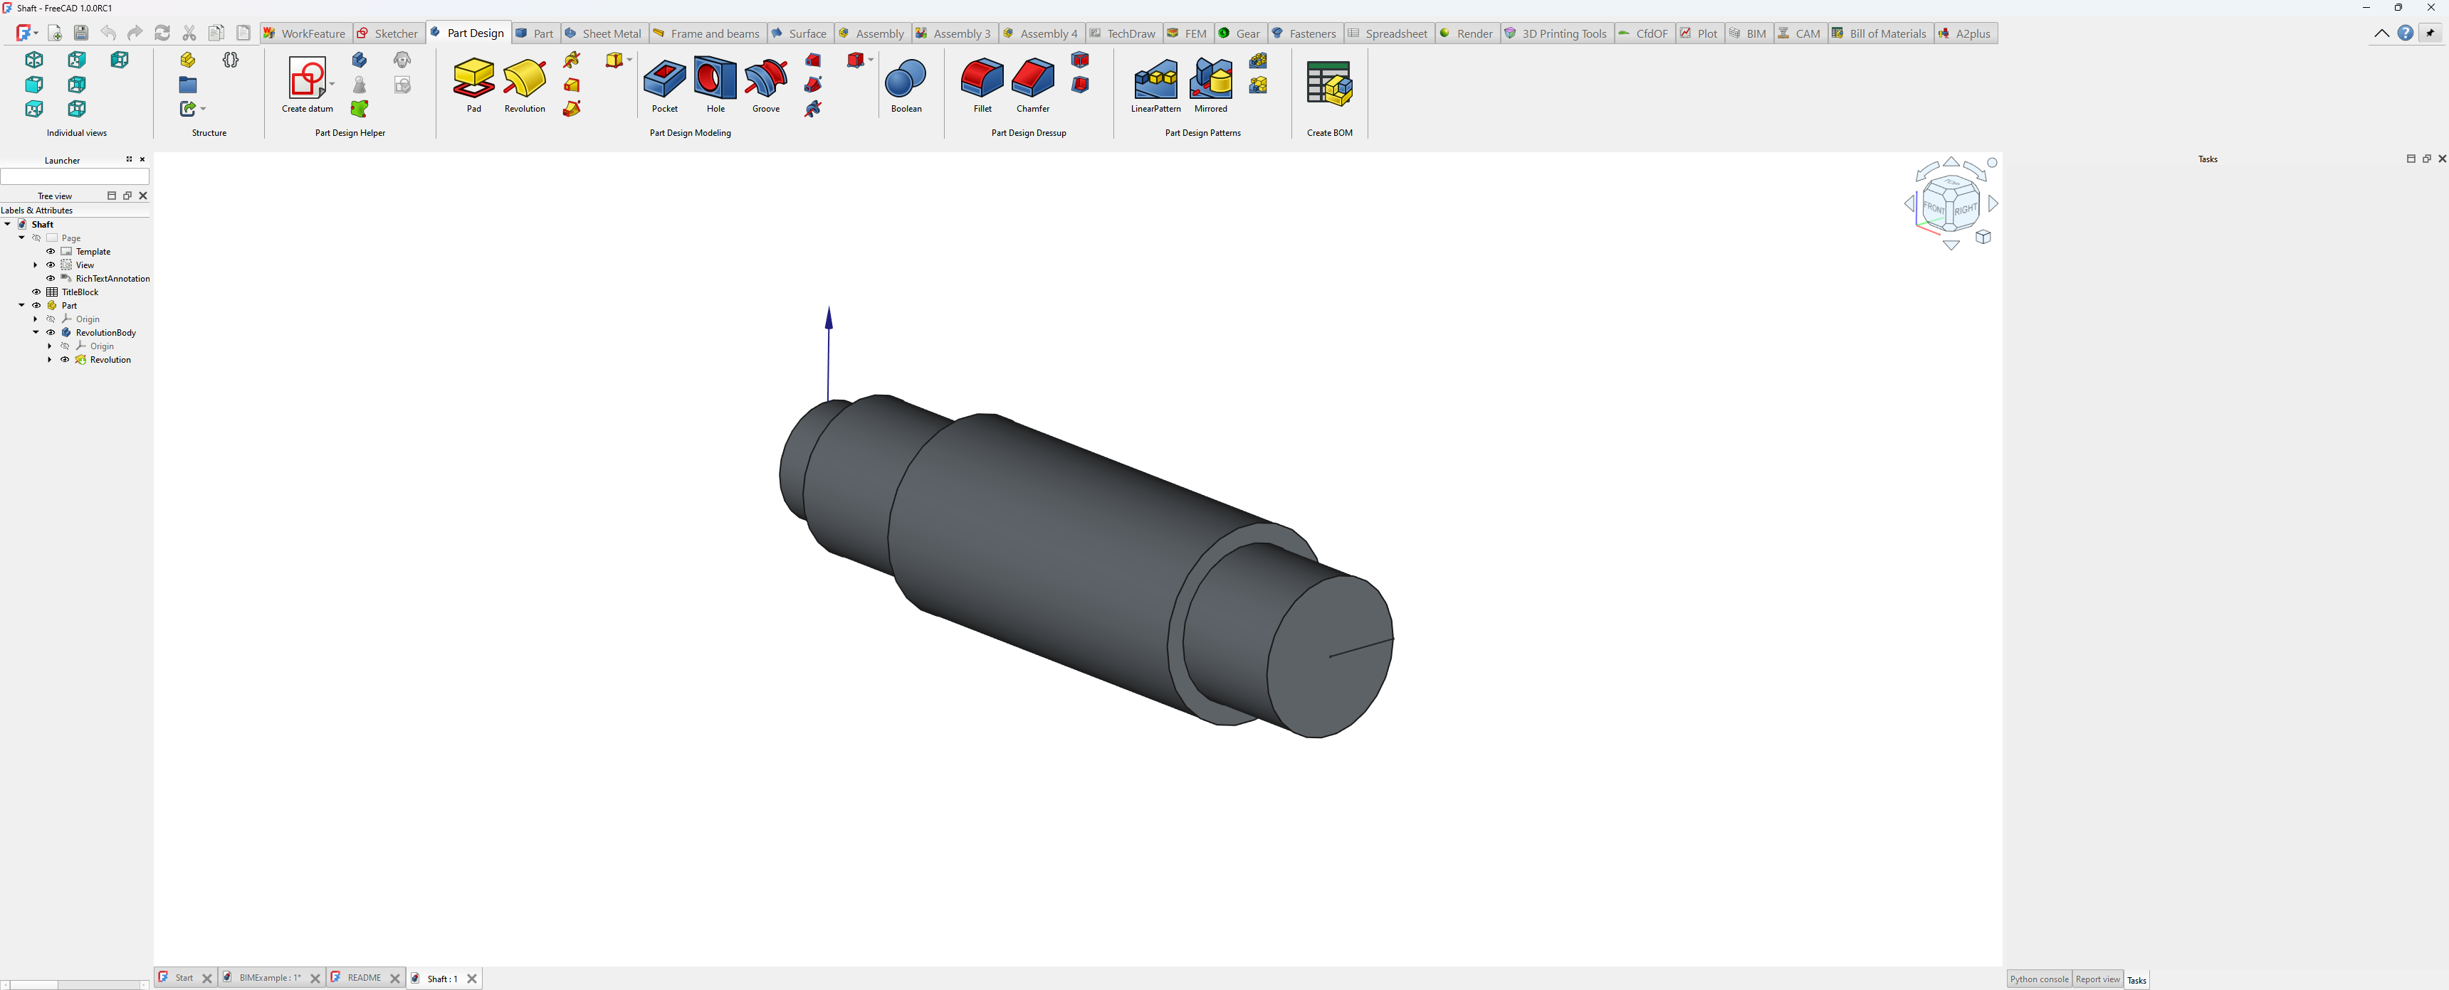
Application menu
Quick access toolbar
Ribbon tab bar
Ribbon panel
Right toolbar

Slide 2
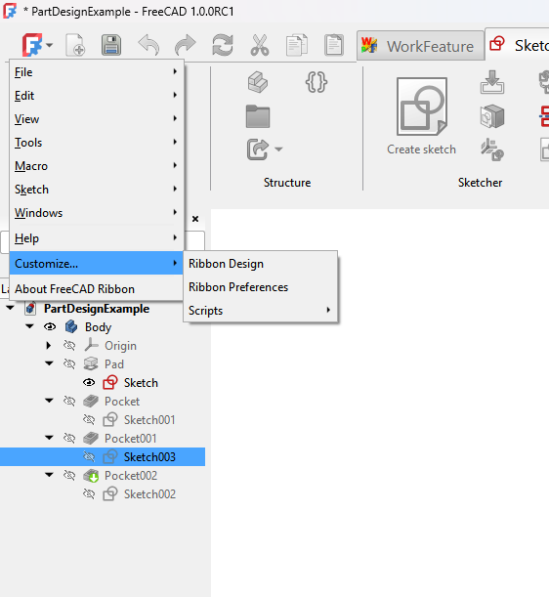
FreeCAD menus
Ribbon customize menus
Link to home page in wiki

Slide 3
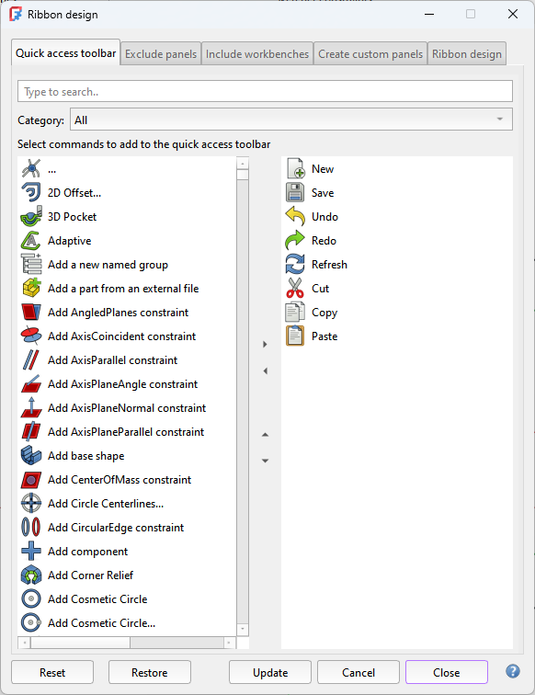
Tab bar
Link to the wiki page

Slide 4
Tab bar
Filter section
Commands to add
Added commands

